Slide 1
Main Reasons to Select LSTM
LSTMs are well-suited for handling sequences of data, making them effective for time series where the order of events is crucial.
LSTMs have a memory cell that can retain information over long periods.
This memory capability is beneficial for capturing trends, seasonality, and other long-term patterns in sneaker prices.
Sneaker prices may be influenced by past prices, and LSTMs can effectively model and capture time lags in the data.
The ability to learn from and remember past information is crucial for accurate price predictions.

Slide 2
Approach to use LSTM with the dataset provided
Approach is that we will select , for a particular sneaker, with SKU as driving factor and grouping them by day instead of hours
Insights are been Drawn from Random Forest about what are the high importance features.
Approach is that using the selected feature
By Taking previous 6 input features as input, predicting the output just like we did in the classroom to predict the chance of a letter occurring after a particular letter ("Hell” to predict “o” to be a word “Hello”)
Using Feature selection, we determined "SIZE", "RETAILPRICE", "min“,"Number_of_days_since_released", max (max price) . So, we are passing 5,1 matrices as an input variable, split the data as 70 to test, 10% to validation and 20% to test, we tried it across LSTM, GRU, CONV1D. GRU and Conv1D have high MSE, but we expect it to still be able to predict the price. If we had the data with high frequency, we are confident that we can predict the price using other methods.

Slide 3
Feature preprocessing
We used standard Scalar from sklearn to do preprocessing of data.
It basically convert the data so that it has standard distribution with mean 0 and standard deviation to 1. This reduces outliers which effects models like Gradient descents.
Then we used a little function that combine past 6 days of data into a single cell and 7th predicted variable as its y label.

Slide 4
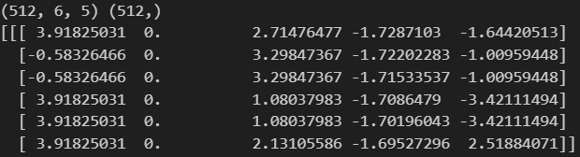
We are converted each column to have multiple data points so five rows from above converts to just one column
0 | 1 | 2 | 3 | 4
0 | 3.918250 | 0.0 | 2.714765 | -1.728710 | -1.644205
1 | -0.583265 | 0.0 | 3.298474 | -1.722023 | -1.009594
2 | -0.583265 | 0.0 | 3.298474 | -1.715335 | -1.009594
3 | 3.918250 | 0.0 | 1.080380 | -1.708648 | -3.421115
4 | 3.918250 | 0.0 | 1.080380 | -1.701960 | -3.421115

Slide 5
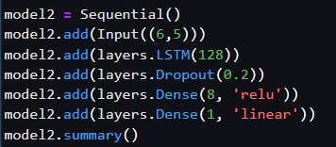
Splitting the data and model details
We did our data split to 70% train, 10% to validation, 20% test.
we are using default activation functions as tanh and recurrent activation of sigmoid. Tanh helps to keep the data between –1 and 1 with 0 has center this will help the gates to know what data to keep in the memory and what to forget
Drop out help in reducing the overfitting of the data.

Slide 6
Model saving and parameters
This help to save the best model when running and later you can load that model. Adam helps in adapting the learning rates of each parameter individually, based on the past gradients.

Slide 7
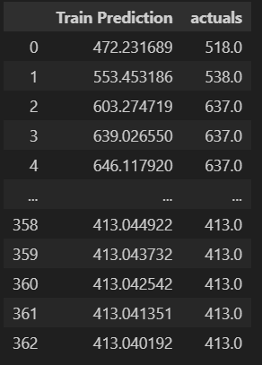
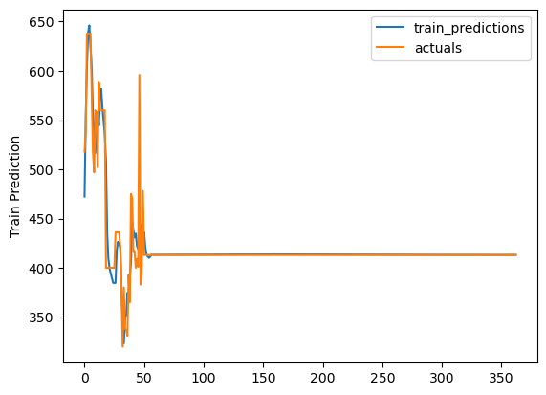
Train Predictions with loss of 0.0306
Training Predictions

Slide 8
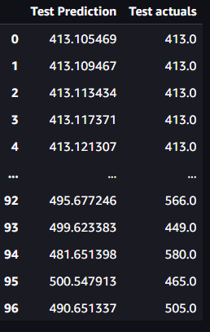
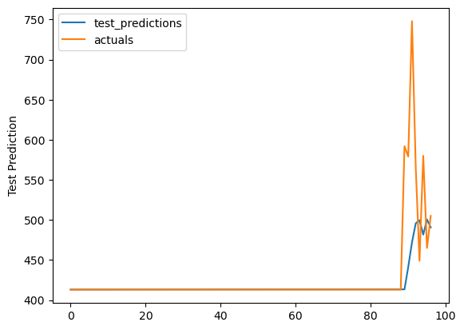
Test Predictions with loss 0.968

